Slide 1

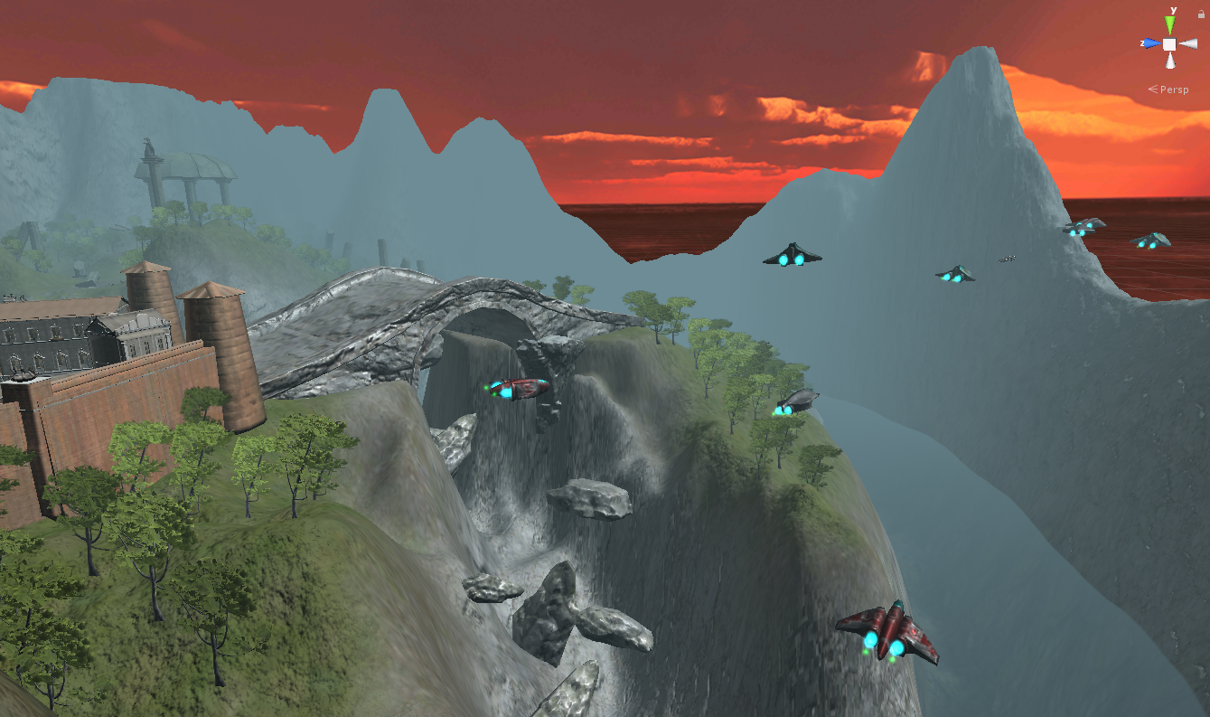
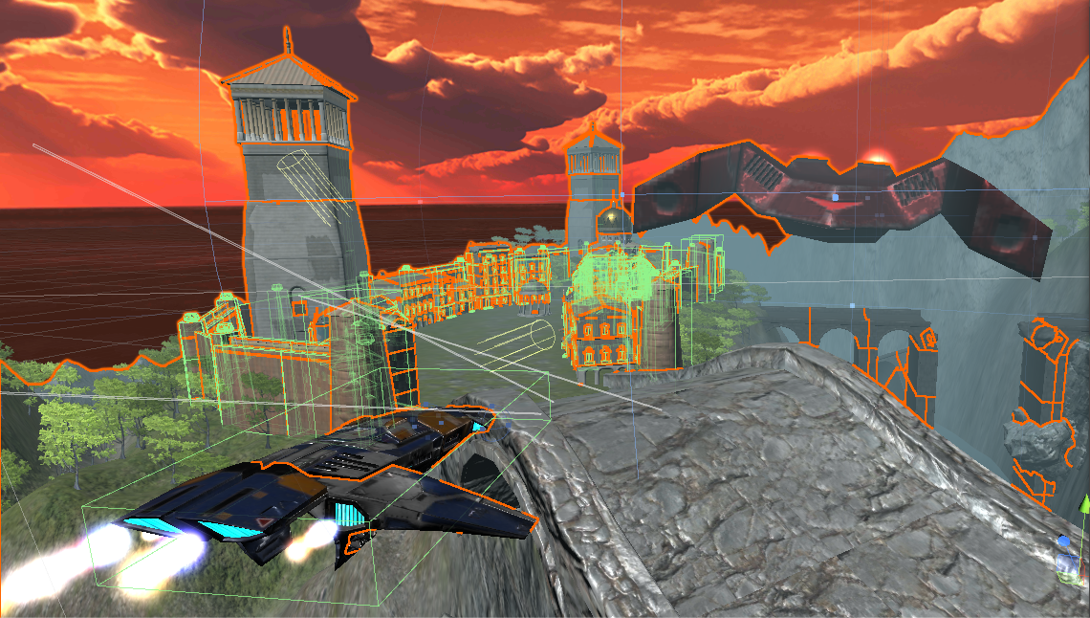
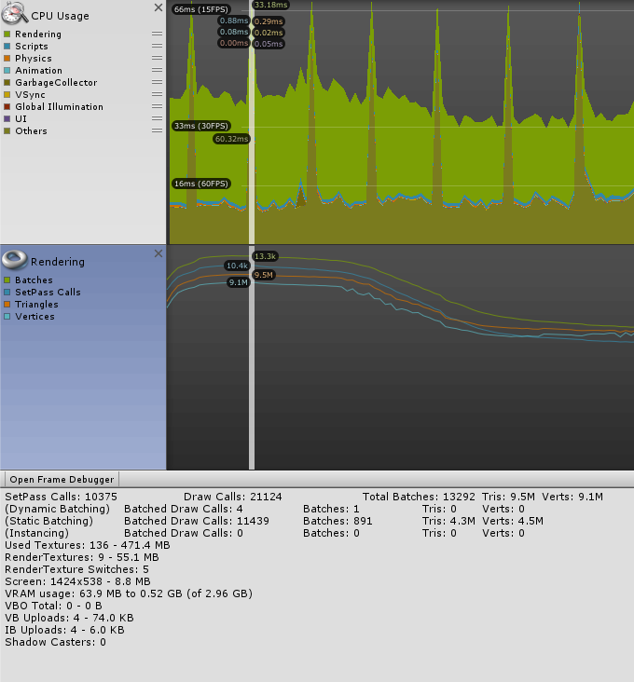

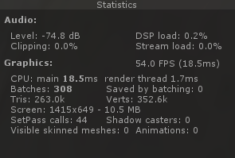





Unity 3D Mobile Game Development
A project by Constantinos Constantinou with Dr. Mario Kolberg
BSc Computing Science (Hons)
Introduction
The aim of this project is to develop a 3D Mobile Game using Unity Engine and investigate the game performance on different platforms.
Inspired by the classic 1997 Nintendo 64 game Star Fox 64. A scrolling shooter game themed around aircraft combat and avoiding collisions.
The player can move around the path but cannot truly stop or change direction whilst their goal is to achieve the highest score.
Features
Unity Scripts in C#
Realistic Water Animation with Reflection
Enemy Waves and Boss Fights
High Quality Materials/Textures/Particles/Sound FX
Timelines Animation
Mesh Collision
Cross-Platform
Quality VS Performance
Feel free to scan me to watch a gameplay and have a small inside taste of the project!
Smooth gameplay on Android platform by balancing the overall quality without affecting performance.
It will require to use the Unity Profiler for problem diagnosis and performance optimization.
Technology Used:
coc00031@students.stir.ac.uk

